Slide 1
All Wales cost of living online summit: Health and care services breakout session
Mind the gap: The cost-of-living crisis and health inequalities in Wales
March 2023

Slide 2
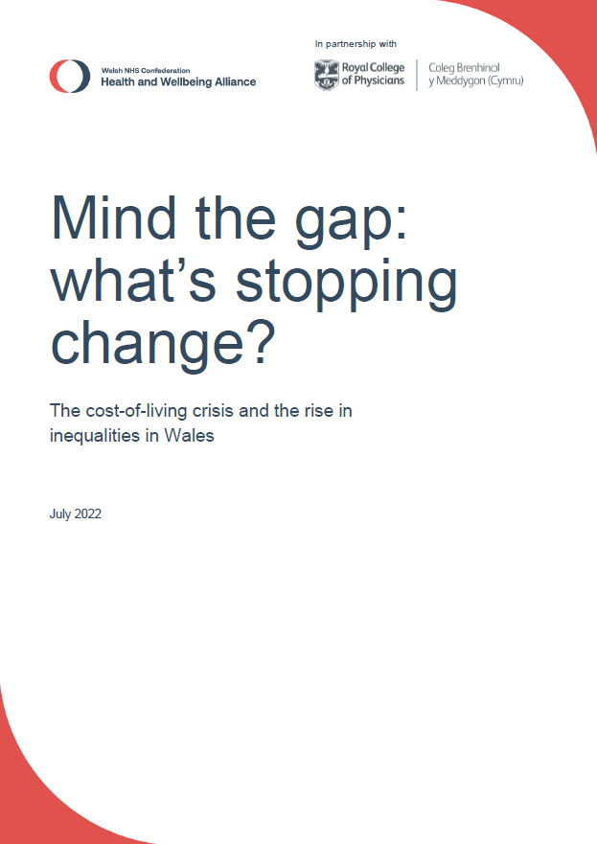
Key messages
Poverty causes ill-health and illness: the cost-of-living crisis is a health crisis.
We need a cross-government delivery plan setting out what every department is doing to tackle inequalities, how they are working together to break down silos, how success will be measured and evaluated, and how Welsh organisations can collaborate to reduce ill-health and tackle the cost-of-living crisis.

Slide 3
At a glance
60% of people in Wales say the rising cost-of-living has had a negative impact on their wellbeing (RCP)
Health inequalities cost the Welsh NHS £322 million every year (Public Health Wales).
Wales now has the worst child poverty rate of all the UK nations at 31% (End Child Poverty).
One in ten Welsh households live in insecure housing (Bevan Foundation).
People in Wales face a higher risk of dying in poverty than any other UK nation (Marie Curie).
Almost 60% of adults in Wales are living with overweight or obesity (Public Health Wales).
The full social cost of obesity to Wales is around £3 billion a year (Frontier Economics).
12% of Welsh households are at least one month behind on a bill (Bevan Foundation).
Child poverty has increased in 20 of 22 local authorities over the past 5 years (End Child Poverty).

Slide 4
Why is this important?
Polling for the RCP has found that 74% of people in Wales feel increasingly worried about their ability to stay warm and healthy at home this winter and 70% are planning to use less heating in their home due to rising energy bills. 11% even said they wouldn’t heat their home as needed even if cold weather could make a member of their household unwell or an existing health condition worse.
The Bevan Foundation has found that 45% of Welsh households never have money for anything other than the basics and the majority of people are now cutting back on essential items like heating, food, clothes and transport. 43% of people in Wales have seen their mental health deteriorate as a result of their financial position while 30% have seen a deterioration in their physical health.

Slide 5
What needs to change?
‘Tackling poverty cannot be seen as a singular issue and that is why we take a government-wide, long-term approach in Wales.’ – Welsh government, September 2022
We welcome the Welsh government’s commitment to reducing inequalities across a range of policy areas, but we now urge ministers to establish a cross-government taskforce, led by the first minister, to drive change at scale and pace through a coordinated national action plan.
‘Cold overcrowded homes, poor education, rising crime, lack of opportunity: these things can’t be addressed via the health service. The NHS is just left dealing with the consequences – recurrent asthma attacks because a child is living in damp rental accommodation; depression in a 50 year old factory worker who has lost his job due to osteoarthritis and, with poor literacy skills, is struggling to find new employment so is falling into poverty and becoming desperate; recurrent falls in a frail older person without a care package. These are the things that medicine can’t fix.’ – GP, October 2022

Slide 6
Closing the implementation gap
The Welsh government should:
consolidate commitments on reducing inequalities and map out existing activity on public health, inequalities, poverty reduction and social security in one delivery plan to improve accountability
provide more detailed national implementation guidance to local delivery bodies and introduce health impact assessment regulations as a priority
develop a shared set of performance measures focused on reducing inequalities and improve access to high-quality, robust data for evaluation

Slide 7
Closing the implementation gap
The Welsh government should:
improve access to prevention programmes based in primary and community care, especially for those living in poverty, and invest in innovation including screening programmes, vaccines and wearable technology
ensure that funding encourages collaboration and is linked to tackling inequalities and require regional partnership boards (RPBs) and public service boards (PSBs) to tackle inequalities.

Slide 8
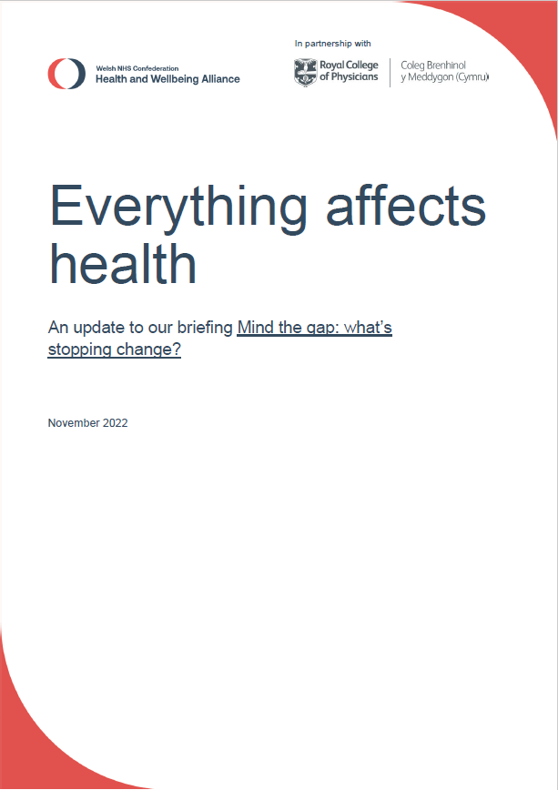
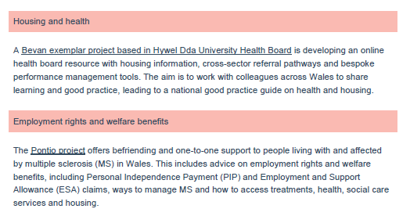
From discussion to action …

Slide 9
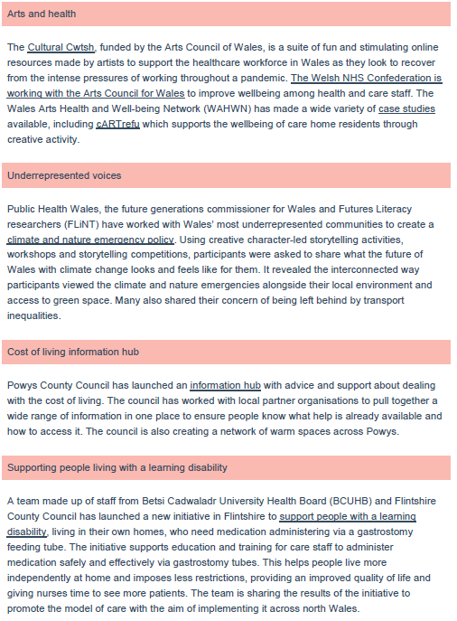
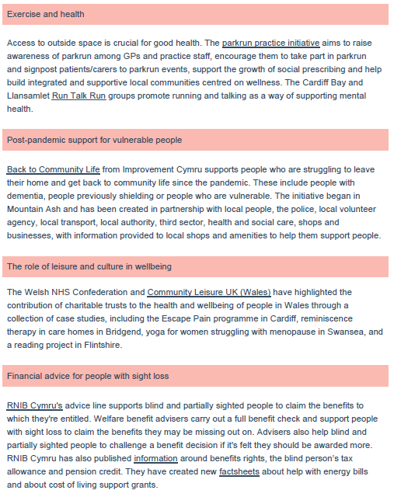
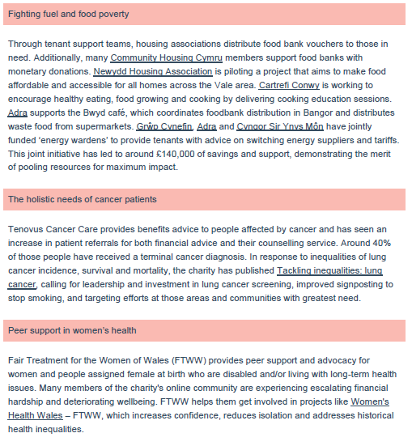
From discussion to action …

Slide 10
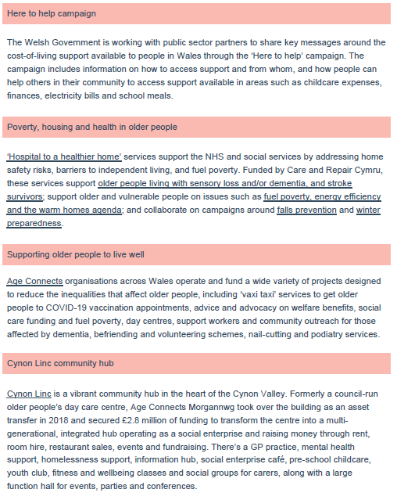
From discussion to action …
Marmot review recommendations (2010)
Give every child the best start in life
Enable all children, young people and adults to maximise their capabilities and have control over their lives
Create fair employment and good work for all
Ensure healthy standard of living for all
Create and develop healthy and sustainable places and communities
Strengthen the role and impact of ill health prevention
So what can we do to help?

Slide 11
Questions to consider
What are the barriers and enablers to an effective response to equitably address need?
What examples of good practice and effective partnership working currently exist?
What additional support do you think would be beneficial to mitigate the impacts of the cost of living crisis at national, regional and local levels?
What opportunities are there to further collaborate across sectors in supporting a short, medium and long-term response, including using data and involving communities?
What top 3 actions would you like to see to make a difference?

Slide 12
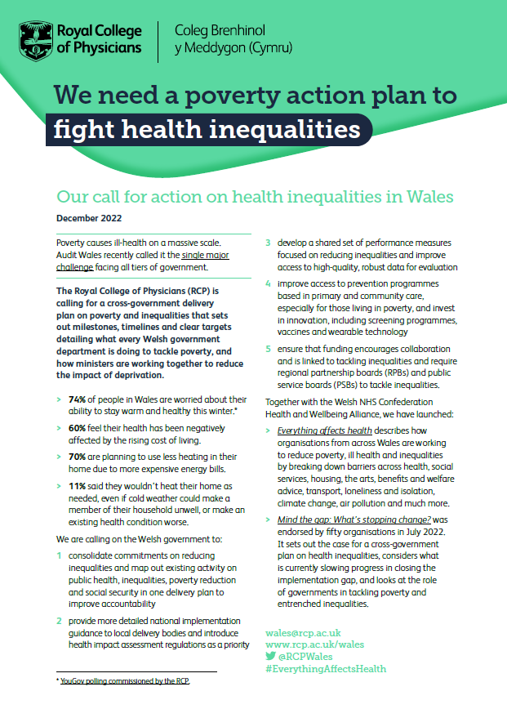
To download the Mind the gap report, visit nhsconfed.org/MindTheGap
To download the Everything affects health case studies, visit nhsconfed.org/publications/everything-affects-health
To download the RCP’s one-page briefing, visit rcp.ac.uk/Wales

Slide 13
Diolch
am wrando
Thank you
for listening
For more information, contact Lowri.Jackson@rcp.ac.uk

