Slide 1
Mental Health & Cost of Living
Simon Jones
Head of Policy & Campaigns
Mind Cymru

Slide 2
Outline
Context: Impact of the pandemic
Mental Health and Poverty
Impact of Cost of Living Crisis

Slide 3
Context: Impact of Pandemic
Everyone’s mental health impacted by the pandemic and the measures we had to take
Whilst population level mental health rebounded once measures started to relax, some groups experienced a more lasting impact
Decrease in referrals to support and some evidence of increased self stigma preventing people from seeking help
Children and young people, Black and ethnic minority communities, people with existing mental health conditions and those experiencing poverty all reported poorer mental health outcomes
Pre-pandemic mental health system was already under pressure and inequalities a significant issue

Slide 4
Mental Health & Poverty
“Money and mental health problems can be a marriage made in hell” Martin Lewis
Poverty is both a cause and an effect of poor mental health
Money & Mental Health Policy Institute (MMHPI) found that employment rate for people with a mental health problem is 42% points lower in Wales than those without a mental health problem
28% of 25 – 54 year olds who are economically inactive list mental health as the main reason
People experiencing poor mental health 3.5x more likely to be in problem debt

Slide 5
Impact of Cost of Living
Financial concerns first identified during the pandemic
70% of young people said during the pandemic that thoughts about theirs or their family’s financial situation or jobs made their mental health worse. This made them twice as likely than adults to say that thoughts about finances had a negative impact on their mental health (35%).
Bevan Foundation Poverty Snapshot found 48% of people in Wales saying their mental health is being negatively affected by their finances
Starting to see financial worries becoming a driver in people seeking help with their mental health
Similar groups those most impacted by the pandemic and those experiencing the hardest times with cost of living

Slide 6
Safeguarding: a definition
Safeguarding means protecting a citizen’s health, wellbeing and human rights; enabling them to live free from harm, abuse and neglect.
(NHS England)
Notes:
I need to state that I am assuming some knowledge here. But I think having a broad definition like this is helpful.
Not pure about abuse and neglect.
Reiterate ‘breadth’ of Safeguarding in general – but how much to talk about this? Unsure?
Think about that bit ‘harm, abuse and neglect’. Leads to next slide – we are considering vulnerability factors that can impact on individual ability to protect themselves (or those they care for) from harm, abuse and neglect.

Slide 7
Vulnerability: People and situations
Notes:
From the last slide – we are considering vulnerability factors that can impact on individual’s ability to:
protect themselves from harm, abuse and neglect
Protect those they care for, have responsibility for, from harm, abuse and neglect
Prioritise their needs / preventative care – may include self neglect
Prioritise the needs of children and those they care for – may be actively/ intentionally neglectful and/or passive neglect

Slide 8
Examples of Impact:
parents reduced focus on the child’s needs for food, warmth and suitable clothing
household stress can increase coercion and domestic abuse – child experiences emotional and harm
using drugs and alcohol (CYP and adults alike)
social isolation: eg older people and those with disability
risk of financial exploitation, abuse and coercion (inter and extra familial)
physical health conditions deteriorate
neglect by carers (intended or not)
self-neglect and lack of focus on own health needs
worry about their parents and siblings: feeling anxious about struggling with costs, low self esteem and poor emotional health – caring responsibilities
decreased educational attainment related to hunger, poor living conditions (damp, cold) and possible fears of eviction
possible isolation and bullying from no money and being different
enduring poverty impacts long term wellbeing
risk of criminal exploitation and coercion – drawn in to make money
Notes:
Relating this back to definition Safeguarding means protecting a citizen’s health, wellbeing and human rights; enabling them to live free from harm, abuse and neglect.

Slide 9
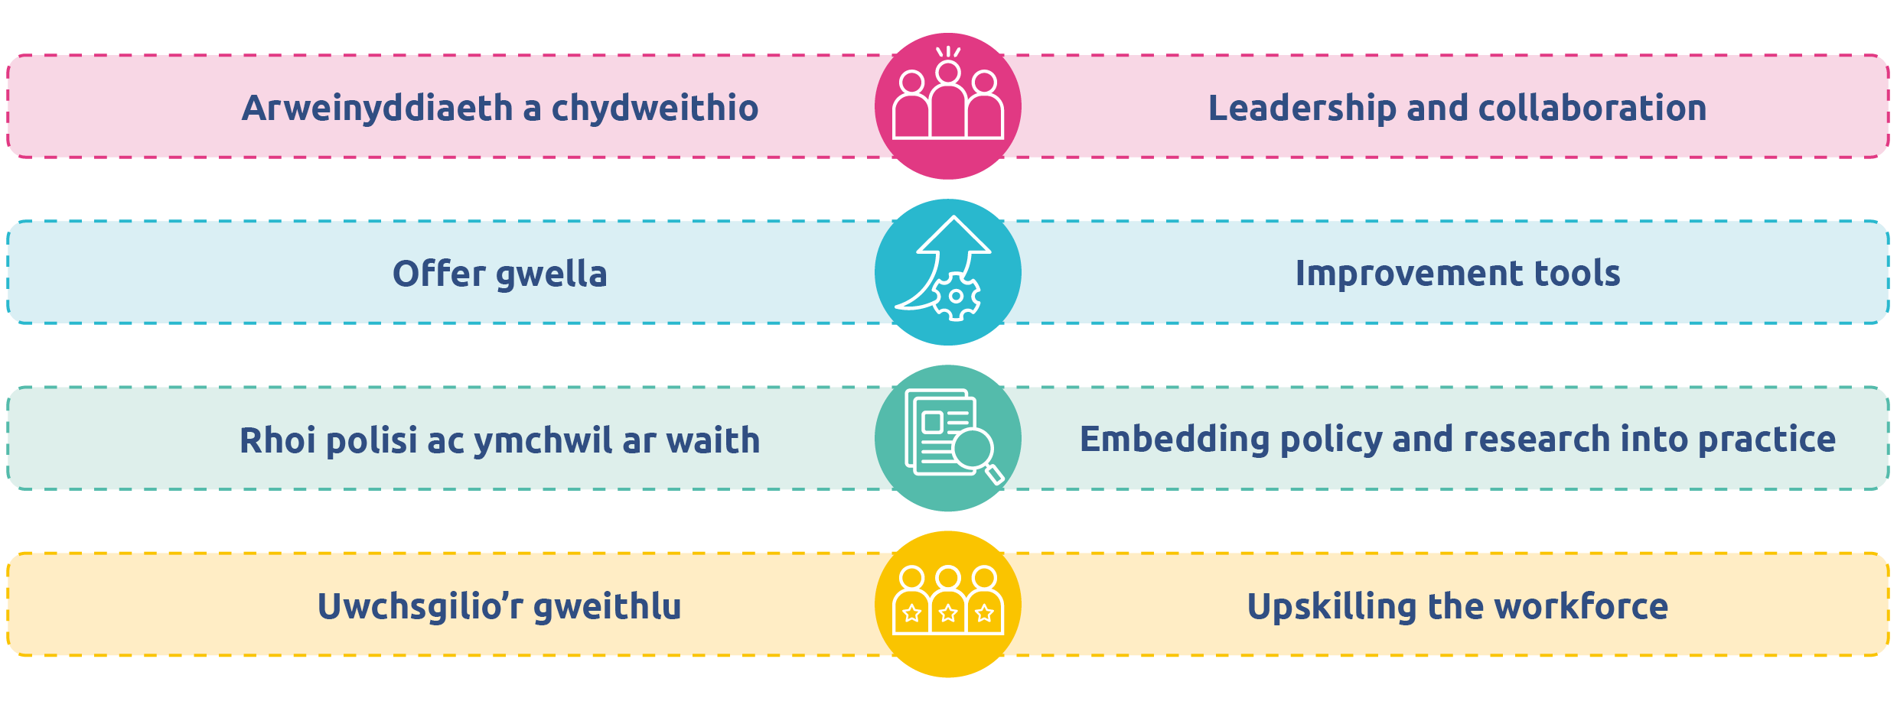
Thank you for listening
Annette Blackstock
Nyrs Ddynodedig
Designated Nurse

