Slide 1
A participatory systems mapping approach to exploring education achievement in Wales – a reflection on theory and practice
Dull mapio systemau cyfranogol ar gyfer archwilio cyflawniad addysgol yng Nghymru – myfyrdod ar theori ac ymarfer
Cathrine Winding & Christian Heathcote-Elliott
29/02/24

Slide 2
Cydnabyddiaeth
Acknowledgements
Rydym yn ddiolchgar iawn i’r bobl ganlynol a gyfrannodd at ddatblygu’r map systemau:
Cyfranogwyr yn y gweithdai
Catrin Lyddon a Troy Wey am gefnogi’r gweithdai
Gweithwyr ieuenctid yng Nghynghorau Bwrdeistref Sirol Conwy a Thorfaen a arweiniodd y gweithdai plant a phobl ifanc
Aelodau o Fwrdd y Prosiect Bwlch cyrhaeddiad addysgol ac iechyd – deall y system
Dr Natalie Savona, Cordis Bright
Yr Athro David Egan, ymgynghorydd addysg allanol
Andrea Parr, yr Uned Penderfynyddion Ehangach Iechyd
We are very grateful to the following people who contributed to developing the systems map:
Participants in the workshops
Catrin Lyddon and Troy Wey for supporting the workshops
Youth workers in Conwy and Torfaen County Borough Councils who led the children and young people’s workshops
Members of the Education attainment gap and health - understanding the system Project Board
Dr Natalie Savona, Cordis Bright
Professor David Egan, external education consultant
Andrea Parr, Wider Determinants of Health Unit
Public Health Wales
2

Slide 3
Heddiw
Today
1
Fframio’r mater
3
Gwaith cyflawniad addysg
4
5
Dysgu
6
Mapio systemau
Ymagwedd mapio
2
Pam y gwnaethom y gwaith hwn
2
Framing the issue
3
Education achievement work
4
5
Learning
6
Systems mapping
Mapping approach
1
Why we did this work
Public Health Wales
3

Slide 4
Pam y gwnaethom y gwaith hwn
Why we did this work
Mae addysg yn garreg sarn tuag at iechyd a lles
Education is a building block to health & well-being
Llawer o waith iechyd cyhoeddus ar ysgolion fel lleoliad ar gyfer ymyriadau iechyd
Lots of public health work on schools as a setting for health interventions
Angen deall y cyd-destun
Need to understand the context
Ble y gallwn ychwanegu gwerth
Where can we add value
Public Health Wales
4
Notes:
Education a key important determinant of health & inequalities (eg WHO CC data in attached (not saying you need to show this)
Lots of PH work on schools as a setting for health interventions
- We needed to understand what issues were important, what else was happening & opportunities
- As a small team focusing on health determinants, we wanted to consider where we could add value
4

Slide 5
Fframio’r mater
Framing the issue
Syml /
Simple
Dyrys /
Complicated
Cymhleth /
Complex
Dof /
Tame
Drygionus /
Wicked
1
1
Anodd /
Difficult
Anhrefn / Messes
2
2
Public Health Wales
1. Rimmel (1972)
5
2. Ackoff (1979)
Notes:
5

Slide 6
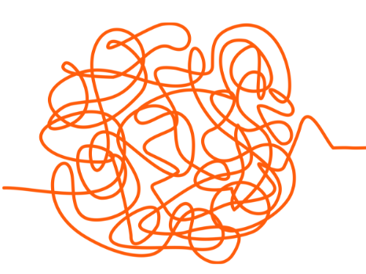
Nodweddion anhrefn
Characteristics of messes²
Anodd ei diffinio
Nid yw’n agored i ddatrysiadau syml
Ansicrwydd
Nifer o ffactorau cydberthynol
Gall meddwl ‘perthynol’ systemig helpu i ddeall a rheoli anhrefn
Hard to pin down
Not amenable to simple solutions
Uncertainty
Multiple interrelated factors
Systemic ‘relational’ thinking can be helpful in understanding and managing messes
Public Health Wales
2. Ackoff (1979)
6
Notes:
Linear thinking unhelpful in trying to make sense and manage messes
Many public health challenges can be considered messes
6

Slide 7
Cyflawniad addysgol fel anhrefn
Educational achievement as a mess
Gwahanol safbwyntiau ar rôl addysg
Mae ‘bwlch cyrhaeddiad addysgol’ parhaus yn gysylltiedig ag anfantais economaidd-gymdeithasol
Mae addysg yn llwybr tuag at iechyd ac mae iechyd yn llwybr tuag at gyflawniad addysgol
Different views on the role of education
Persistent ‘educational attainment gap’ gap related to socio-economic disadvantage
Education is a pathway to health and health is a pathway to educational achievement
Public Health Wales
7
Notes:
Education – two words in latin for education
Educare – to train or mold - mean the preservation and passing down of knowledge and the shaping of youths in the image of their parents
Educere – to lead out - mean the preservation and passing down of knowledge and the shaping of youths in the image of their parents
7

Slide 8
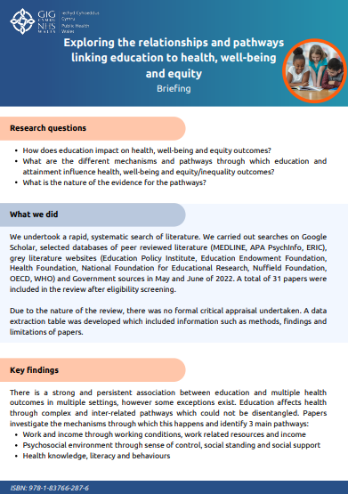
Natur y berthynas rhwng addysg ac iechyd
Nature of the relationship between education and health
Tri llwybr eang a ffactorau cyfryngu
Llwybrau rhyng-gysylltiedig
Llenyddiaeth yn draddodiadol yn edrych ar gyrhaeddiad addysgol oherwydd argaeledd data
Three broad pathways and mediating factors
Interconnected pathways
Literature traditionally looks at educational attainment due to accessibility of data
Public Health Wales
8
Notes:
We undertook a literature review of the relationships and pathways linking education to health, well-being and equity.
We found that there are 3 broad pathways which I’ll show in the next slide – work and income; psycho-social environment; health knowledge, literacy and behaviours. These are interconnected pathways, influenced by many factors.
The literature looks very much at ATTAINMENT - the level of education obtained or years in education and grades rather than mot holistically – quality of education, life skills and knowledge, emotional and social well-being etc.
- Overall a very broad scope – chronic pain, Musculoskeletal Conditions, social wellbeing, self-rated mental health

Slide 9
Llwybrau addysg ac iechyd
Education and health pathways
Gwaith ac incwm
Work and income
Addysg
Education
Gwybodaeth, llythrennedd ac ymddygiad iechyd
Health knowledge, literacy and behaviours
Canlyniadau iechyd
Health outcomes
Amgylchedd seico-gymdeithasol
Psycho-social environment
Public Health Wales
Source: Hahn and Truman. Education Improves Public Health and Promotes Health Equity. 2015
9
Notes:
This is from a model from one of the papers in the literature review – simplified diagram of the pathways

Slide 10
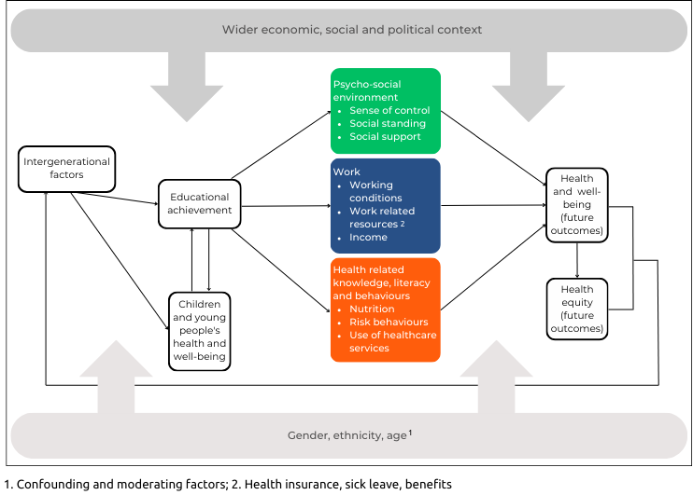
Llwybrau o addysg i iechyd (a fabwysiadwyd o fodelau a diagramau a amlygwyd yn yr adolygiad o lenyddiaeth Archwilio’r perthnasoedd a’r llwybrau sy’n cysylltu addysg ag iechyd, llesiant a thegwch)
Pathways from education to health (adopted from models and diagrams identified in the Exploring the relationships and pathways linking education to health, well-being and equity literature review)
Public Health Wales
Source: Winding C. et al. Exploring the relationships and pathways linking education to health, well-being and equity: Briefing. Public Health Wales NHS, 2023.
10

Slide 11
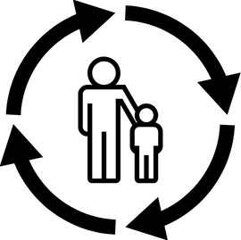
Pwyntiau i’w hystyried
Points for consideration
Llai o ffocws ar ffactorau ar lefel unigol
Cyd-destunol, hanesyddol, gwleidyddol
Gall addysg barhau cylchoedd anfantais o un genhedlaeth i’r llall ac economaidd-gymdeithasol
Gwahaniaethau ethnigrwydd a rhyw o ran effaith addysg ar ganlyniadau iechyd
Less focus on individual-level factors
Contextual, historical, political
Education can perpetuate cycles of intergenerational and socioeconomic disadvantage
Ethnicity and gender differences in the effect of education on health outcomes
Public Health Wales
11
Notes:
Future research should focus less on the individual level factors (Specific grade or years in education) -> Levels of numeracy and literacy; quality of education and structural factors
Education and achievement is contextual, historical and political (different from country to country even region to region) – One paper suggests that education “may improve health and mortality less in Europe, where health care tends to be universal and economic inequality is generally lower” as compared to the United States, for example, where universal healthcare does not exist
While education provides opportunities and increase to opportunity to live a healthy life it can also perpetuate cycles of intergenerational and socio-economic disadvantage
Lastly, the evidence shows there are ethnicity and gender differences in the effect of education on health outcomes. A US study found differences in those with Hispanic ethnicity compared to White Americans. A study from Australia found that women with higher education might have better health because they invest more in healthier behaviours and social capital
11

Slide 12
Mapio systemau
Systems mapping
Dyfais ar gyfer dysgu
Casglu offer a dulliau
Mae mapio systemau cyfranogol³ yn fodd o ddatblygu model meddyliol a rennir gyda rhanddeiliaid
Mae’n cynnwys gwneud penderfyniadau ynglŷn â ffiniau
Device for learning
Collection of tools and methods
Participatory systems mapping³ is a way of developing a shared mental model with stakeholders
Involves making boundary judgements
Public Health Wales
3. Barbrook & Penn (2022)
12
Notes:
Device for learning about a situation and making improvements + many different ways of doing system mapping – rich pictures, influence map, context map, network analysis or social network analysis- some of these involve mathematical modelling and specialised softwares
A collection of tools and methods
Participatory systems mapping² is a way of developing a shared mental model with others using causal loop diagramming. So you typically develop the map with partners and stakeholders, or if it’s an internal thing you could develop it with your team
What’s in the map and external (environment) is based on boundary judgements – what’s within the scope of your map and what’s out of scope
12

Slide 13
Ymagwedd mapio
Mapping approach
3 gweithdy ar-lein gan ddefnyddio MIRO 3 online workshops using MIRO
Amlygwyd ffactorau o dan 5 thema Identified factors under 5 themes
Cysylltwyd y ffactorau gan grwpiau gweithdai Workshop groups connected factors
Cysoni proses mapiau draft Synthesising process of draft maps
Gweithdy dilysu Validation workshop
Adborth ar y ffactorau a’r map gan blant a phobl ifanc Feedback on factors and map from children and young people
Public Health Wales
13
Notes:
- 3 online workshops with 30 partners and subject experts from health and education
Started by identifying factors under 5 pre-determined themes (education, child and family, economic, social and community, other) – this changed later in the process
Moved onto placing the factors on a blank ‘paper’ with educational achievement in the middle and think about how they connect together
Synthesising process
Validation workshop with small group of attendees
CYP feedback on factors and map
- Looks very linear but it’s an iterative process
13

Slide 14
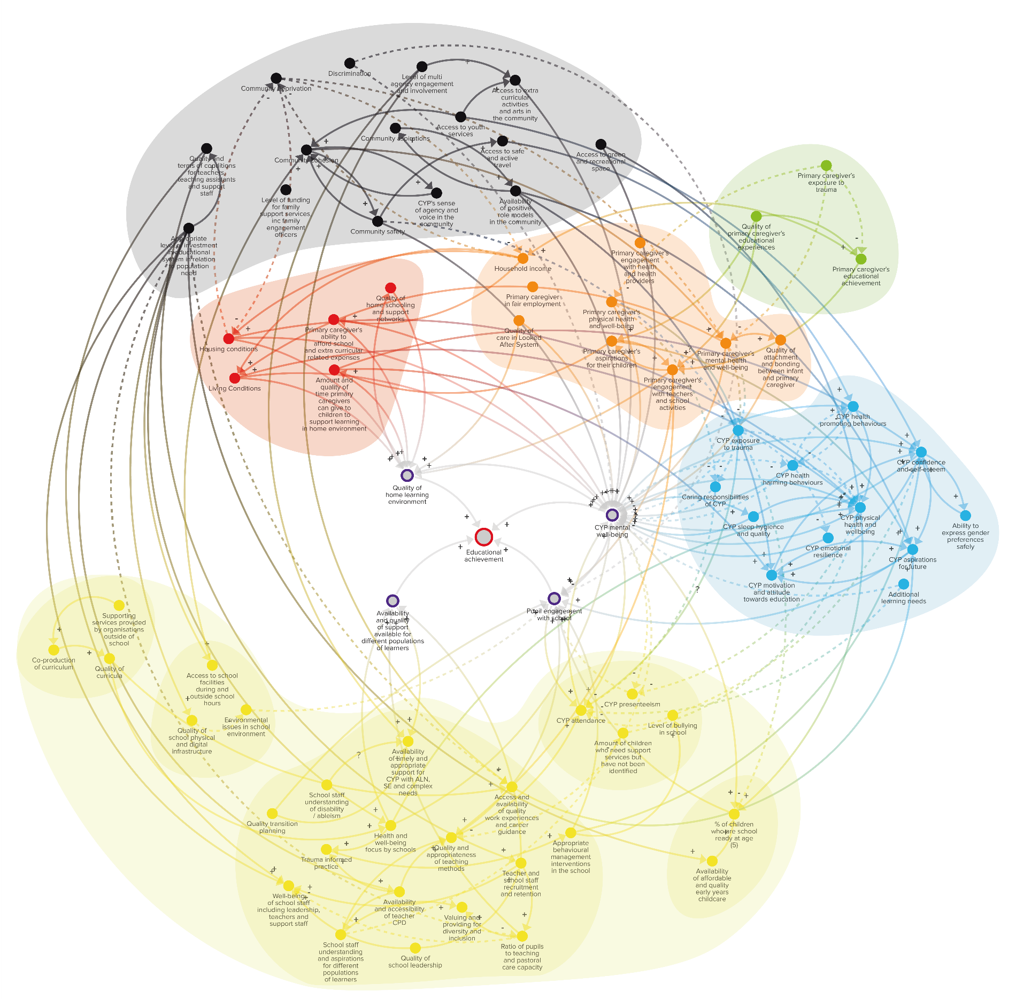
Fersiwn derfynol y map
Final version of the map
Adrodd y stori …
Telling the story…
Public Health Wales
14
Notes:
5 themes.
When we’ve presented the map it’s been important to tell the story of the map – we start with the ‘core factors’ in the model and work our way through the map

Slide 15
Educational Achievement in Wales Systems map - YouTube

Slide 16
Pwyntiau i’w hystyried
Key messages
Mae cyflawniad addysgol yn digwydd o ganlyniad i lwybrau achosol cymhleth
Mae iechyd meddwl da a lles wedi’u gysylltu gynhenid â dysgu
Educational achievement is the result of complex causal pathways
Good health and mental well-being are intrinsically connected to learning
Mae annerch y ffactorau y tu allan i’r ysgol yn hollbwysig i wella cyflawniad addysgol
Mae tarfu cylchau anfantais yn gallu dod a buddion i genedlaethau’r dyfodol
Addressing factors outside the school is fundamental to improving educational achievement
Disrupting cycles of disadvantage can bring benefits to future generations
Public Health Wales
16

Slide 17
Gwerth y map systemau
Value of the systems map
Y stori y mae’n ei hadrodd i ni
Caniataodd i ni weithio gyda chydweithwyr i fapio gweithgareddau Iechyd Cyhoeddus Cymru
Amlygu ble mae llai o weithgarwch o safbwynt iechyd cyhoeddus
Buddion ychwanegol
Cynghrair rhwng arweinwyr Ysgolion Bro ac Iechyd Cyhoeddus Cymru
Defnyddio gwybodaeth i gefnogi gwaith Llywodraeth Cymru ar leihau’r bwlch cyrhaeddiad
The story it tells
Allowed us to work with colleagues to map Public Health Wales activities
Identify where from a public health perspective there is less activity
Additional benefits
Alliance between Community Focused Schools leads and Public Health Wales
Using insights to support WG work on reducing attainment gap
Public Health Wales
17
Notes:
CHE:
The story it tells of the connections between health & education have been valued by those working in the field, and especially in schools and education
- We’ve worked with others in PHW to show the range of activities covering the map – suggest we show this as we have a nice simple image of it
-It demonstrates the breadth of PHW activity that can have an impact on this determinant
-It avoids us duplicating work happening & look to build on the impact of existing programmes & also helped us recognise that developing a shared understanding of systems influencing education for health has value for others own right -It identifies areas where there is less happening from a PH perspective (home learning environment)
-It has also had spin off benefits in ways we hadn’t originally planned:
-Community focused school leads – and helped them identify support they wanted from PHW – and allowed connections to be drawn with health promoting school schemes – leading to a strong alliance between these programmes
-Working with WG on how the insights can help support thinking on narrowing the attainment gap and support work on attendance
17

Slide 18
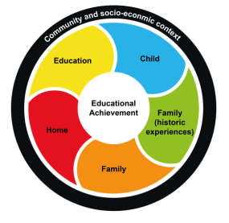
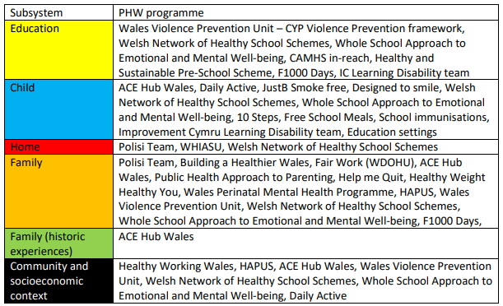
Gwerth y map systemau
Value of the systems map
“Rwy’n dwlu ar y map systemau. Byddwn i wedi hoffi ei greu fy hun. Mae’n dangos y cymhlethdod rydyn ni’n delio ag ef. Bydd yn ddefnyddiol iawn yn ein gwaith.”
“I love the systems map, I wished I had been able to create this, it shows the complexity that we are dealing with. It will be hugely helpful in our work.”
Public Health Wales
18
Notes:
Figure 1. Simplified diagram of the Factors affecting educational achievement in Wales - Systems map
18

Slide 19
Yr hyn a ddysgwyd – damcaniaethol a chysyniadol
Our learning – theoretical and conceptual
Deall diben mapio
Mae’n bwysig cyfateb y diben i’r math o fap systemau
Mae system o ddiddordeb yn offeryn cysyniadol – bydd ffiniau ac is-systemau’n dibynnu ar ddiben a chanfyddiadau rhanddeiliaid
Ystyriwch gymhlethdod ymarferol
Mae angen i’r map adrodd stori
Clarity on purpose of mapping
Matching purpose to type of systems map is important
System of interest is a conceptual tool – boundaries and subsystems will depend on purpose and perceptions of stakeholders
Consider actionable complexity
Map needs to tell a story
Public Health Wales
19
Notes:
Purpose
- What are you trying to do and achieve? For what? Being clear on this will help you choose the right tools/methods (e.g. the right kind of systems map)
Boundaries, boundaries, boundaries!
- This determines the scope of your system of interest and your map. It helps with narrowing your thinking, considering who you involve, who you engage with etc
- Actionable complexity: Complexity approaches, however, run the risk of exposing policy makers to overwhelming complexity—situations in which revealing the reality of the situation paralyzes action. The map should be a powerful tool for enhancing understanding and communicating complexity and offers a means to identify levers, feedback loops, and causal cascades that could help to design complexity-appropriate policy interventions that exploit system structure. Without guidance, models that demonstrate complexity may simply be intimidating. This is from a specific paper on how to help policy makers (I’ll share the appear in the chat) but it applies to all complex models
19

Slide 20
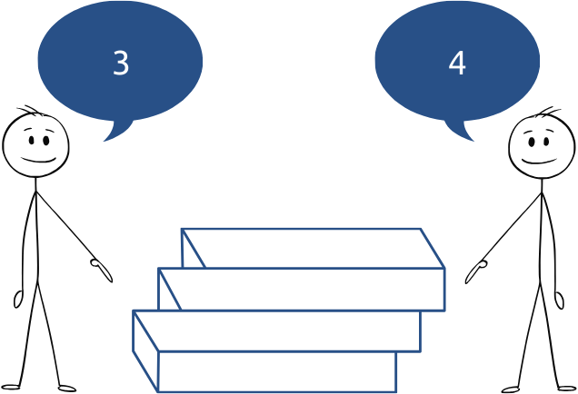
Yr hyn a ddysgwyd - ymarferol
Our learning - practical
Ceisiwch gyngor – mae’n fwy anodd nag y mae’n edrych!
Os gallwch ei wneud wyneb yn wyneb, gwnewch hynny!
Nid oes ‘ffurf’ gywir nac anghywir ar gyfer map systemau
Gwnewch yn siŵr fod y dechnoleg yn addas i chi
Gall mapiau systemau ddod yn ddiriaethol – un fersiwn o realiti ydynt
Seek advice – it’s harder than it looks!
If you can do it in person, do it!
There’s no right or wrong ‘look’ for a systems map
Make sure tech is right for you
Systems maps can become reified – they are one version of reality
Public Health Wales
20
Notes:
- Expert advice or really look into the different kinds of maps and the best methods for developing your map
Facilitating something like this online is really hard work and the tech can fail!
Illusion = reality can be so complex that equally valid observations from differing perspectives can appear to be contradictory!
3 P’s – purpose, prep and practice
20

Slide 21
Diolch am wrando – unrhyw gwestiynau?
Thanks for listening – any questions?
Public Health Wales
21
Notes:
Purpose: how you want to use the map, e.g. working with stakeholders over time, track interactions and relationships over time (social network analysis), as an evaluation tool, or explore policies and interventions, find leverage points for action
Prep: all the practical stuff that goes into a mapping workshop (a lot!), do you need to do some context mapping to get people to think about your system of interest and what’s within your spheres of influence?
Practice: might need to do it multiple times, rules for guidance, takes practice to get it right, lots of learning
21

Slide 22
Gweithio gyda'n gilydd i greu Cymru iachach Working together for a healthier Wales
Notes:
22

